Slide 1
INDEXES
Definition:
An index is an optional structure, associated with a table or table cluster, that can sometimes speed data access. Indexes are schema objects that are logically and physically independent of the data
Benefits of Indexes
The absence or presence of an index does not require a change in the wording of any SQL statement
An index is a fast access path to a single row of data. It affects only the speed of execution.
The index points directly to the location of the rows containing that value.
Indexes are one of many means of reducing disk I/O.

Slide 2
INDEX Key Words
Index Usability & Visibility
An unusable index, which is ignored by the optimizer, is not maintained by DML operations. An unusable index can improve the performance of bulk loads.
An invisible index is maintained by DML operations, but is not used by default by the optimizer.
Index Keys
A key is a set of columns or expressions on which you can build an index.
Composite Indexes
A composite index, also called a concatenated index, is an index on multiple columns in a table.

Slide 3
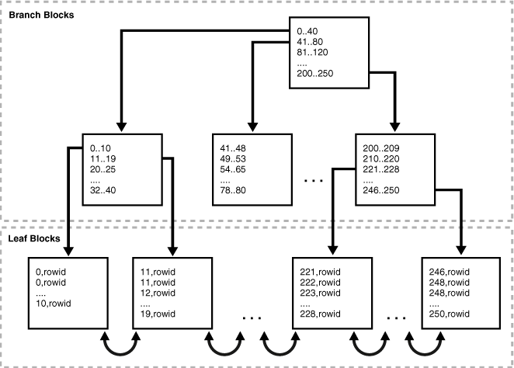
B-Tree Indexes
B-trees, short for balanced trees, are the most common type of database index. A B-tree index is an ordered list of values divided into ranges. B-trees provide excellent retrieval performance for a wide range of queries, including exact match and range searches.

Slide 4
B-Tree Indexes
TYPES
Normal Index
Reverse Key Index
Ascending Index
Cluster Index

Slide 5
B-Tree Indexes
Normal Index
Syntax :
CREATE INDEX <index_name> ON <table_name> ( col_name );
Example :
CREATE INDEX idx_id ON sales (sale_id);

Slide 6
B-Tree Indexes
REVERSE KEY Index
A reverse key index is a type of B-tree index that physically reverses the bytes of each index key while keeping the column order.
Reversing the key solves the problem of contention for leaf blocks in the right side of a B-tree index.
Syntax :
CREATE INDEX <index_name> ON <table_name> ( col_name ) REVERSE;
Example :
CREATE INDEX idx_id ON sales (sale_id) REVERSE;

Slide 7
B-Tree Indexes
Ascending & Descending Index
In an ascending index, Oracle Database stores data in ascending order.
In descending index, the index stores data on a specified column or columns in descending order.
Syntax :
CREATE INDEX <index_name> ON <table_name> ( col_name ASC | DESC);
Example :
CREATE INDEX idx_id ON sales (sale_id DESC);

Slide 8
B-Tree Indexes
UNIQUE Index
Indexes can be unique or nonunique. Unique indexes guarantee that no two rows of a table have duplicate values in the key column or columns.
In a unique index, one rowid exists for each data value. The data in the leaf blocks is sorted only by key
For a nonunique index, the rowid is included in the key in sorted order
Syntax :
CREATE UNIQUE INDEX <index_name> ON <table_name> ( col_name );
Example :
CREATE UNIQUE INDEX idx_id ON sales (sale_id);

Slide 9
FUNCTION-BASED Index
A function-based index computes the value of a function or expression involving one or more columns and stores it in an index.
The indexed function can be an arithmetic expression or an expression that contains a SQL function, user-defined PL/SQL function or package function
Example :
CREATE INDEX emp_total_sal_idx
ON employees (12 * salary * commission_pct, salary, commission_pct);
CREATE INDEX upper_ix ON employees (UPPER(last_name));

Slide 10
Creating a Cluster Index: Example
Syntax:
CREATE INDEX <index_name> ON CLUSTER <cluster_name>;
Example :
CREATE INDEX idx_personnel ON CLUSTER personnel;

Slide 11
Bitmap Indexes - Overview
Bitmap indexes store the rowids associated with a key value as a bitmap. Each bit in the bitmap corresponds to a possible rowid. If the bit is set, then it means that the row with the corresponding rowid contains the key value.
Situations that may call for a bitmap index include:
The indexed columns have low cardinality, that is, the number of distinct values is small compared to the number of table rows.
The indexed table is either read-only or not subject to significant modification by DML statements.
Value | Row 1 | Row 2 | Row 3 | Row 4 | Row 5 | Row 6 | Row 7
M | 1 | 0 | 1 | 1 | 1 | 0 | 0
F | 0 | 1 | 0 | 0 | 0 | 1 | 1

Slide 12
Bitmap Indexes - Overview
SELECT COUNT(*)
FROM customers
WHERE cust_gender = 'F'
AND cust_marital_status IN ('single', 'divorced');
Value | Row 1 | Row 2 | Row 3 | Row 4 | Row 5 | Row 6 | Row 7
M | 1 | 0 | 1 | 1 | 1 | 0 | 0
F | 0 | 1 | 0 | 0 | 0 | 1 | 1
single | 0 | 0 | 0 | 0 | 0 | 1 | 1
divorced | 0 | 0 | 0 | 0 | 0 | 0 | 0
single or divorced, and F | 0 | 0 | 0 | 0 | 0 | 1 | 1

Slide 13
Bitmap Indexes - Example
Syntax :
CREATE BITMAP INDEX <index_name> ON <table_name> (col_name);
Example :
CREATE BITMAP INDEX idx_gender ON sale (gender);

Slide 14
INDEX PARTITIONS
Creating a Range-Partitioned Global Index: Example
Syntax :
CREATE INDEX <index_name> ON <table_name> (col_name)
GLOBAL PARTITION BY RANGE (col_name)
(PARTITION <part_name_1> VALUES LESS THAN (value_range), …
PARTITION <part_name_n> VALUES LESS THAN (MAXVALUE) );
Example :
CREATE INDEX cost_ix ON sales (amount_sold)
GLOBAL PARTITION BY RANGE (amount_sold)
(PARTITION p1 VALUES LESS THAN (1000),
PARTITION p2 VALUES LESS THAN (2500),
PARTITION p3 VALUES LESS THAN (MAXVALUE));

Slide 15
INDEX PARTITIONS
Creating a Partitioned LOCAL Index: Example
Syntax :
CREATE INDEX <index_name> ON <table_name> (col_name)
LOCAL;
Example :
CREATE INDEX cost_ix ON sales (amount_sold)
LOCAL;

Slide 16
ALTERING INDEX
To Rebuild An Index
Syntax : ALTER INDEX <index_name> REBUILD;
Example : ALTER INDEX idx REBUILD;
To Rename An Index
Syntax : ALTER INDEX <old_index_name> RENAME TO <new_index_name>;
Example : ALTER INDEX idx RENAME TO idx_empid;
To Rename An Index Partition
Syntax : ALTER INDEX <index_name>
RENAME PARTITION <old_part_name> TO <new_part_name>;
Example : ALTER INDEX idx RENAME PARTITION p3 TO q3;

Slide 17
ALTERING INDEX
To Split An Index Partition
Syntax : ALTER INDEX <index_name> SPLIT PARTITION <old_part_name> AT (val)
INTO (PARTITION <new_part_name> , … );
Example : ALTER INDEX idx SPLIT PARTITION p2 AT (500)
INTO ( PARTITION p2a, PARTITION p2b);
To Drop An Index Partition
Syntax : ALTER INDEX <index_name> DROP PARTITION <part_name>;
Example : ALTER INDEX idx DROP PARTITION p2;
To Drop An Index
Syntax : DROP INDEX <index_name>;
Example : DROP INDEX idx ;

Slide 18
INDEX – Data Dictionary Views
USER_INDEXES
USER_IND_COLUMNS
USER_IND_PARTITIONS
USER_IND_SUBPARTITIONS
ALL_INDEXES
ALL_IND_COLUMNS
ALL_IND_PARTITIONS
ALL_IND_SUBPARTITIONS
DBA_INDEXES
DBA_IND_COLUMNS
DBA_IND_PARTITIONS
DBA_IND_SUBPARTITIONS

